Slide 1
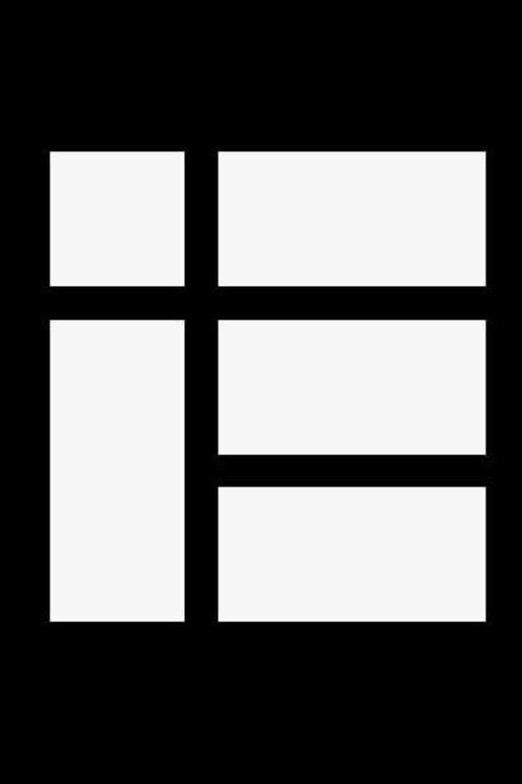

Kotlin Basic Types
Arrays﻿

Slide 2
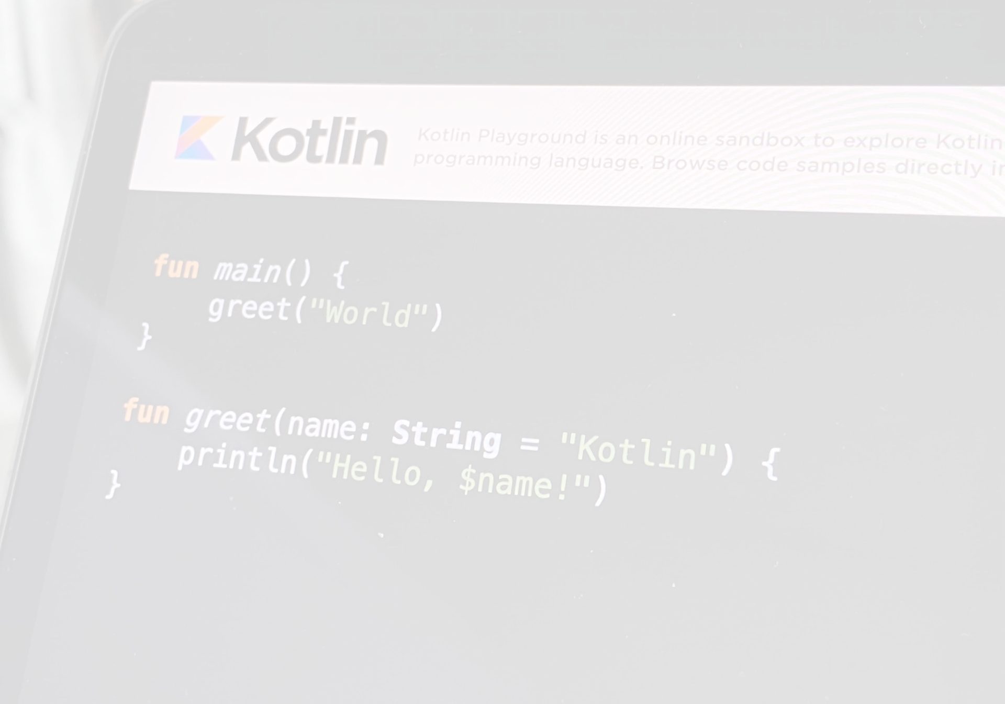
Create Arrays﻿
To create arrays in Kotlin, you can use:
functions, such as arrayOf(), arrayOfNulls() or emptyArray().
the Array constructor.
This example uses the arrayOf() function and passes item values to it:
// Creates an array with values [1, 2, 3]
val simpleArray = arrayOf(1, 2, 3)
println(simpleArray.joinToString())
// 1, 2, 3
This example uses the arrayOfNulls() function to create an array of a given size filled with null elements:
// Creates an array with values [null, null, null]
val nullArray: Array<Int?> = arrayOfNulls(3)
println(nullArray.joinToString())
// null, null, null
This example uses the emptyArray() function to create an empty array :
var exampleArray = emptyArray<String>()
You can specify the type of the empty array on the left-hand or right-hand side of the assignment due to Kotlin's type inference.
For example:
var exampleArray = emptyArray<String>()
var exampleArray: Array<String> = emptyArray()

Slide 3
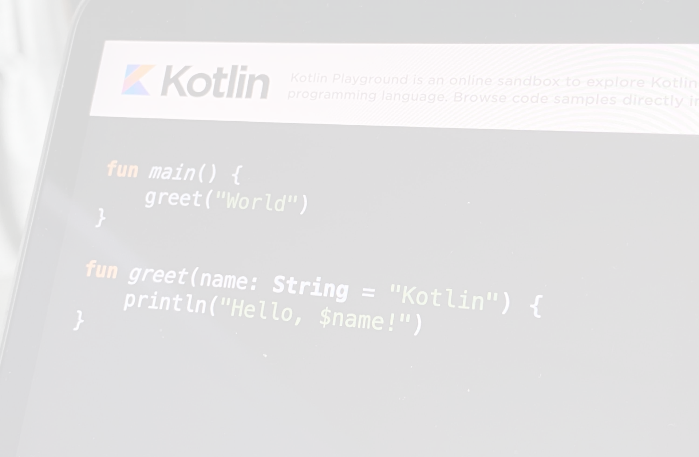
The Array constructor takes the array size and a function that returns values for array elements given its index:
// Creates an Array<Int> that initializes with zeros [0, 0, 0]
val initArray = Array<Int>(3) { 0 }
println(initArray.joinToString())
// 0, 0, 0
// Creates an Array<String> with values ["0", "1", "4", "9", "16"]
val asc = Array(5) { i -> (i * i).toString() }
asc.forEach { print(it) }
// 014916
Nested Arrays﻿
Arrays can be nested within each other to create multidimensional arrays:
// Creates a two-dimensional array
val twoDArray = Array(2) { Array<Int>(2) { 0 } }
println(twoDArray.contentDeepToString())
// [[0, 0], [0, 0]]
​
// Creates a three-dimensional array
val threeDArray = Array(3) { Array(3) { Array<Int>(3) { 0 } } }
println(threeDArray.contentDeepToString())
// [[[0, 0, 0], [0, 0, 0], [0, 0, 0]], [[0, 0, 0], [0, 0, 0], [0, 0, 0]], [[0, 0, 0], [0, 0, 0], [0, 0, 0]]]

Slide 4
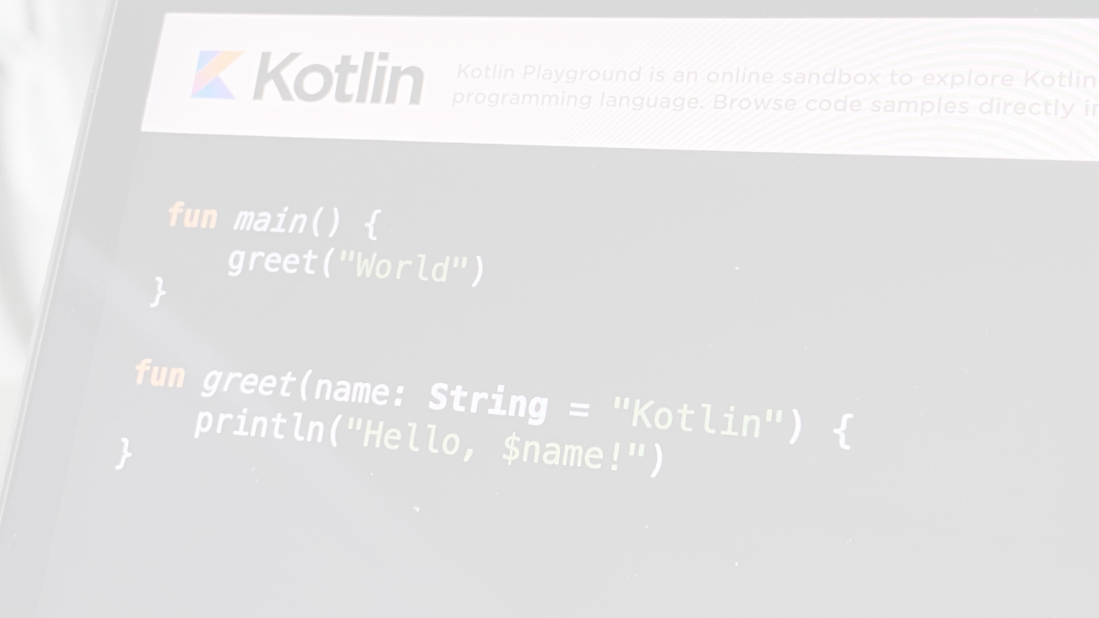
Access & Modify Elements﻿
Arrays are always mutable. To access and modify elements in an array, use the indexed access operator[]:
val simpleArray = arrayOf(1, 2, 3)
val twoDArray = Array(2) { Array<Int>(2) { 0 } }
// Accesses the element and modifies it
simpleArray[0] = 10
twoDArray[0][0] = 2
// Prints the modified element
println(simpleArray[0].toString()) // 10
println(twoDArray[0][0].toString()) // 2
Arrays in Kotlin are invariant. This means that Kotlin doesn't allow you to assign an Array<String> to an Array<Any> to prevent a possible runtime failure. Instead, you can use Array<out Any>.

Slide 5
Work with Arrays﻿
Pass variable number of arguments to a function﻿
To pass an array containing a variable number of arguments to a function, use the spread operator (*). The spread operator passes each element of the array as individual arguments to your chosen function:
fun main() {
val lettersArray = arrayOf("c", "d")
printAllStrings("a", "b", *lettersArray)
// abcd
}
fun printAllStrings(vararg strings: String) {
for (string in strings) {
print(string)
}
}

Slide 6
Compare arrays﻿
To compare whether two arrays have the same elements in the same order, use the .contentEquals() and .contentDeepEquals() functions:
val simpleArray = arrayOf(1, 2, 3)
val anotherArray = arrayOf(1, 2, 3)
// Compares contents of arrays
println(simpleArray.contentEquals(anotherArray))
// true
// Using infix notation, compares contents of arrays after an element
// is changed
simpleArray[0] = 10
println(simpleArray contentEquals anotherArray)
// false

Slide 7
Transform arrays﻿
Sum﻿
To return the sum of all elements in an array, use the .sum() function:
val sumArray = arrayOf(1, 2, 3)
// Sums array elements
println(sumArray.sum())
// 6
Shuffle﻿
To randomly shuffle the elements in an array, use the .shuffle() function:
val simpleArray = arrayOf(1, 2, 3)
// Shuffles elements [3, 2, 1]
simpleArray.shuffle()
println(simpleArray.joinToString())
// Shuffles elements again [2, 3, 1]
simpleArray.shuffle()
println(simpleArray.joinToString())

Slide 8
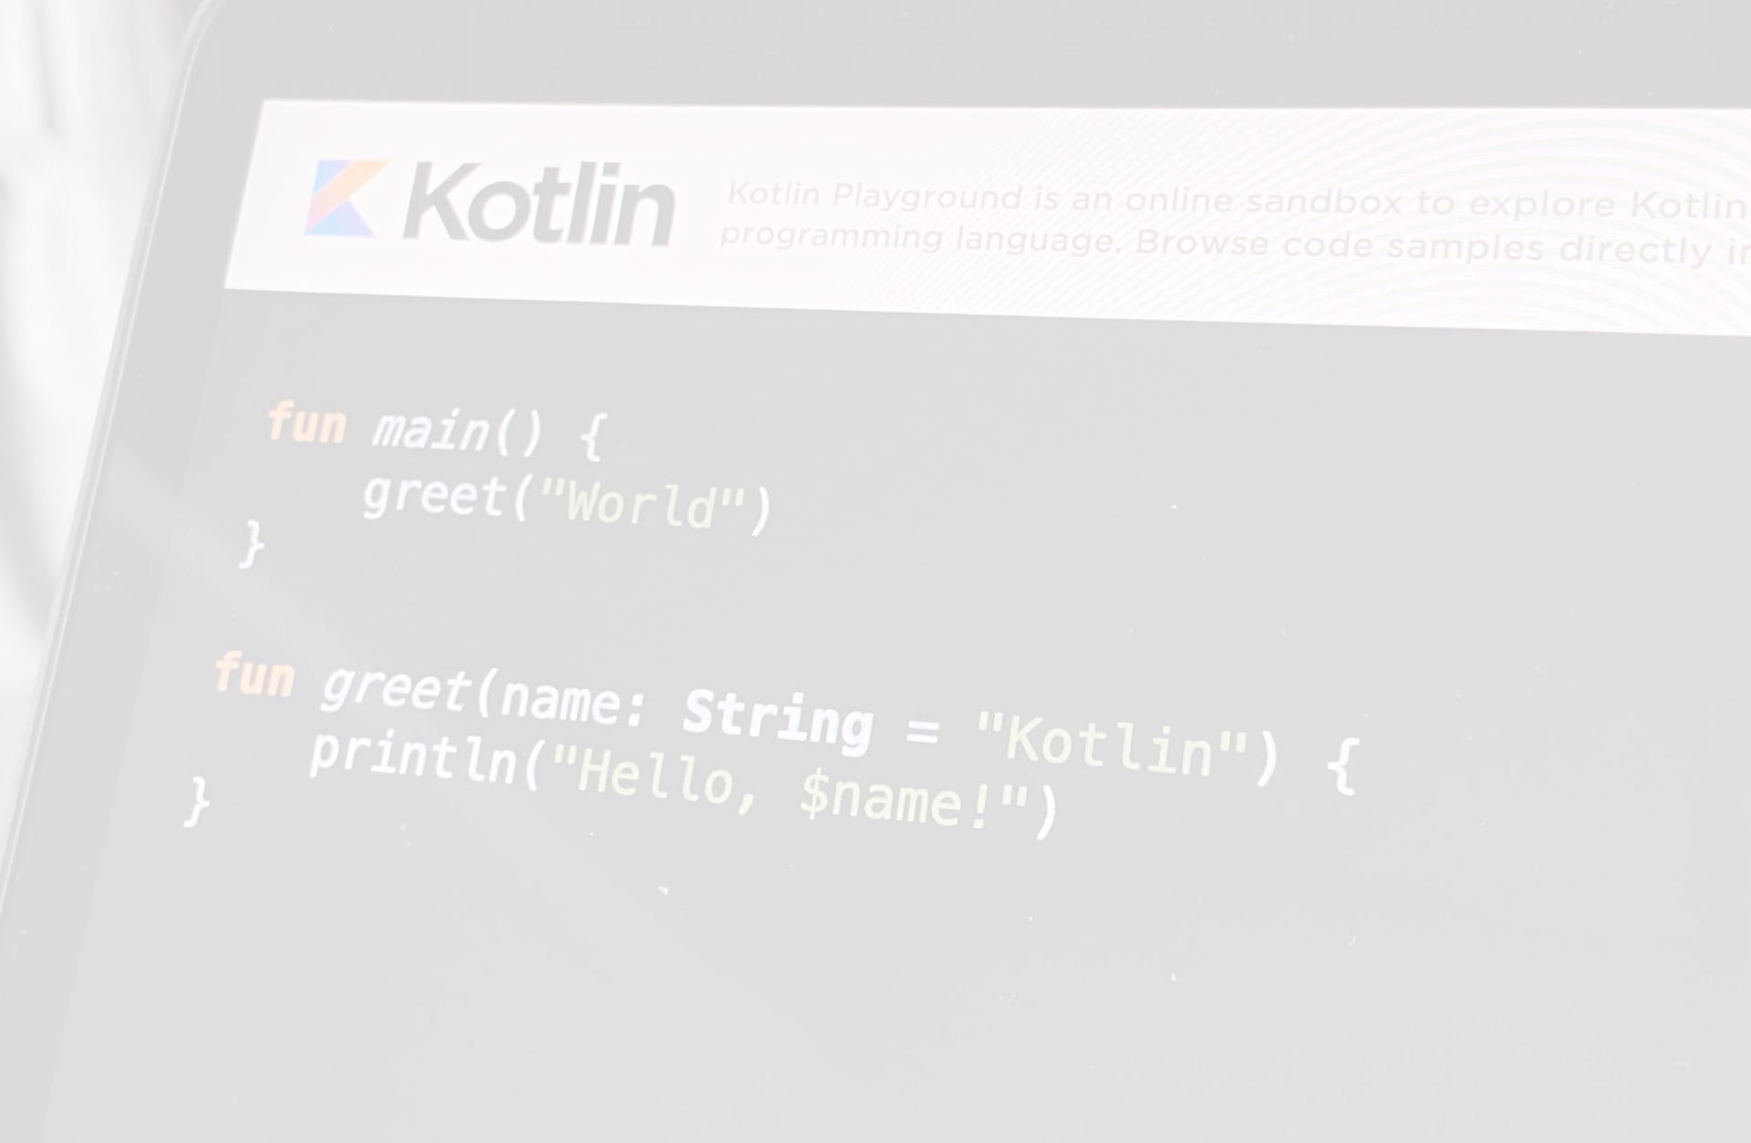
Convert arrays to collections﻿
Convert to List or Set﻿
To convert an array to a List or Set, use the .toList() and .toSet() functions.
val simpleArray = arrayOf("a", "b", "c", "c")
// Converts to a Set
println(simpleArray.toSet())
// [a, b, c]
// Converts to a List
println(simpleArray.toList())
// [a, b, c, c]
Convert to Map﻿
To convert an array to a map, use the .toMap() function.
Only an array of Pair<K,V> can be converted to a map. The first value of a Pair instance becomes a key, and the second becomes a value. This example uses the infix notation to call the to function to create tuples of Pair:
val pairArray = arrayOf("apple" to 120, "banana" to 150, "cherry" to 90, "apple" to 140)
// Converts to a Map
// The keys are fruits and the values are their number of calories
// Note how keys must be unique, so the latest value of "apple"
// overwrites the first
println(pairArray.toMap())
// {apple=140, banana=150, cherry=90}

